Slide 1
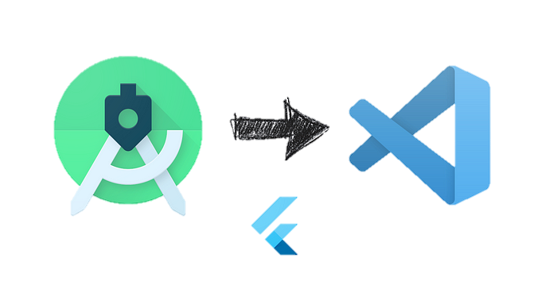

Flutter Tooling and IDE Setup
Setting Up a Basic Flutter Project
A Comprehensive Guide to Getting Started
with Flutter Development
Notes:
Hello everyone, welcome to our session on "Flutter Tooling and IDE Setup Setting up a Basic Flutter Project." Today, we'll delve into the fundamental building blocks of Flutter app development: widgets

Slide 2
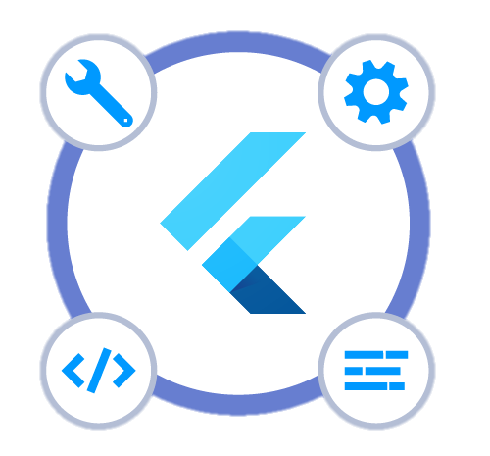
Essential Flutter Tooling
Flutter SDK
  The core Flutter development kit, containing the necessary tools and libraries
  Includes the Dart compiler, flutter runtime, and a collection of pre-built widgets
Dart Editor
  A simple and lightweight IDE for Dart programming
  Offers basic code editing, debugging, and project management features
Visual Studio Code
  A popular and extensible code editor with extensive Flutter support
  Provides a rich set of extensions for debugging, refactoring, and code completion
  Highly customizable and integrates with various tools
Android Studio
  The official IDE for Android development, with built-in Flutter support
  Offers advanced features for Android-specific development
  Suitable for developers with Android development experience
Notes:
Essential Flutter Tooling: Building Your Cross-Platform Dream
Flutter provides a robust set of tools to empower your development journey. Let's explore two key ones:
1. Flutter SDK:
Comprehensive Package: This is the cornerstone of your Flutter development, containing everything you need to get started.
Essential Components:
Dart compiler: Translates your Dart code into machine code understandable by different platforms.
Flutter runtime: Provides the foundation for running your Flutter app on various devices.
Pre-built widgets: Offers a rich library of ready-to-use UI elements to kickstart your development.
2. Dart Editor:
Your Code Hub: This IDE is specifically designed for Dart development, offering a streamlined environment for writing and managing your code.
Core Features:
Basic code editing: Provides syntax highlighting, code completion, and other essential editing tools.
Debugging: Helps you identify and fix errors in your code efficiently.
Project management: Organizes your project files and dependencies for smooth development.
1. Visual Studio Code (VS Code):
Popular & Extensible: A widely used code editor with a vast ecosystem of extensions, including many specifically designed for Flutter.
Customization Powerhouse: Highly customizable interface and workflows to suit your preferences.
Integrations Galore: Integrates seamlessly with various tools and services for a comprehensive development experience.
Debugging & Development Support: Provides extensions for debugging, refactoring, and code completion, enhancing productivity.
Learning Curve: May require some configuration and extension setup for optimal Flutter development.
2. Android Studio:
Official Android IDE: Developed by Google, offering deep integration with Android development tools and features.
Built-in Flutter Support: Includes plugins and features specifically designed for Flutter development.
Android Specialization: Ideal for developers already familiar with Android development, providing advanced features for building native-looking apps.
Limited Extensibility: Offers fewer customization options compared to VS Code.
Performance Considerations: Can be resource-intensive on older machines.

Slide 3
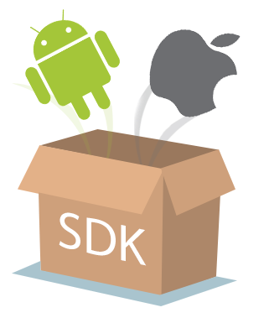

IDE Setup for Flutter Development
Installing the Flutter SDK
  Download the Flutter SDK from the official website.
  Extract the downloaded ZIP file to a designated location.
  Set the FLUTTER_HOME environment variable to point to the extracted SDK directory.
Installing an IDE
  Choose an IDE from the recommended options (Dart Editor, Visual Studio Code, or Android Studio).
  Download and install the selected IDE.
Notes:
1. The Flutter SDK:
Download: Head to the official Flutter website (https://flutter.dev/docs/get-started/install) and grab the SDK for your operating system.
Extract: Unzip the downloaded file to a convenient location on your machine. Remember its path, you'll need it later.
Environment Variable: Set up an environment variable named FLUTTER_HOME that points to the extracted SDK directory. This helps your system locate the necessary tools and libraries.
2. Choosing Your IDE:
Flutter offers several development environments to suit your style:
Dart Editor: A lightweight choice designed specifically for Dart development. Simple and ideal for getting started.
Visual Studio Code: A popular and extensible code editor with a vast ecosystem of Flutter plugins for debugging, refactoring, and more. Highly customizable and integrates with various tools.
Android Studio: The official IDE for Android development, with built-in Flutter support and advanced features for Android integration. Suited for developers already familiar with Android development.

Slide 4
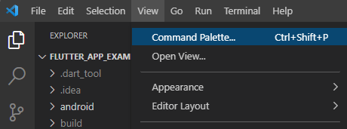
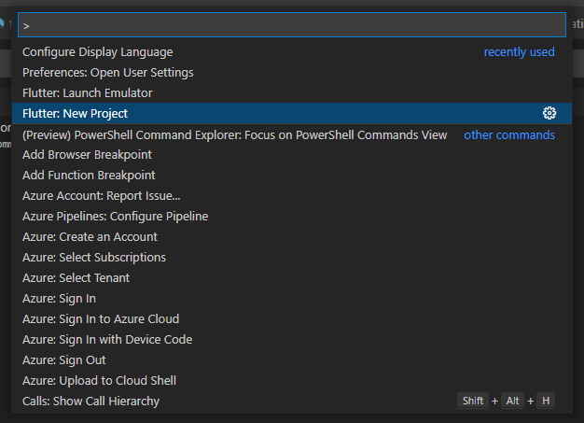
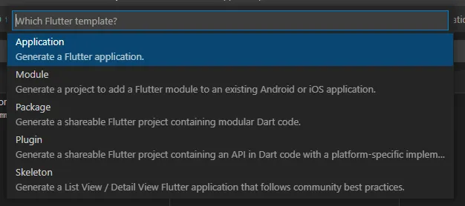
Setting Up a Basic Flutter Project
Creating a New Project
  Open the chosen IDE and create a new Flutter project.
  Specify a project name and location.
  Select the desired device type.
Running the Project
  Choose the desired device or simulator.
  Run the project using the IDE's built-in Run or Debug options
Notes:
1. Creating a New Project:
Open your chosen IDE: Whether it's Dart Editor, Visual Studio Code, or Android Studio, launch it and prepare to create a new project.
Initiate project creation: Look for "New Project" options within your IDE. Each IDE has its specific instructions, so consult their documentation if needed.
Name and location: Choose a fitting name for your project and select a directory on your machine to store it.
Device type (optional): Some IDEs might ask you to specify a target device type (e.g., mobile, web). Choose based on your intended platform for now.
2. Running the Project:
Device selection: Depending on your IDE, choose a physical device, emulator, or simulator to run your app on. Each platform (Android, iOS) might have different options.
Hit the "Run" button: Look for options like "Run", "Debug", or "Start" within your IDE to launch your project.

Slide 5

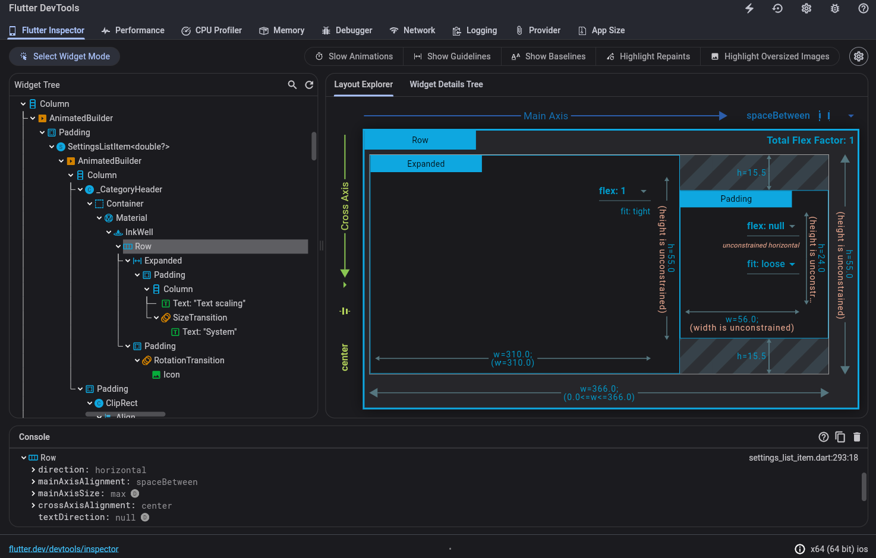
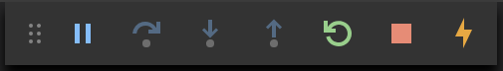

Exploring Flutter Tooling Features
Hot reload
Hot Reload
  Instant feedback during development
  See changes reflected in the app without restarting
  Enhances productivity and reduces development time
Widget Preview
  Visualize widgets without running the entire app
  Inspect widget properties and layout in isolation
  Useful for debugging and designing UI components
Flutter Inspector
  Inspect and modify widget properties in real time
  Debug UI issues and identify performance bottlenecks
  Provides a visual representation of the widget tree
Notes:
1. Hot Reload:
Instant Feedback: Say goodbye to lengthy compile and restart cycles! Witness code changes reflected in the running app instantly, without ever hitting a restart button.
Boost Productivity: Experiment, iterate, and debug faster with Hot Reload's near-magical response time, saving you precious development time.
Enhanced Learning: Explore and learn Flutter by seeing the immediate effects of your code changes, making the learning process more interactive and engaging.
2. Widget Preview:
Isolate and Visualize: Dive into the world of each widget without having to run the entire app.
Inspect & Debug: View widget properties, layout, and interactions in isolation, making debugging and understanding individual components much easier.
Design Efficiency: Experiment with UI designs and layouts quickly and effortlessly, streamlining your design workflow.
3. Flutter Inspector:
Real-time Inspection: Take control and modify widget properties on the fly while the app is running.
Debugging Powerhouse: Identify and fix UI issues in real-time, pinpointing performance bottlenecks with ease.
Visual Widget Tree: Gain a comprehensive understanding of your app's structure by visualizing the widget tree in a clear and organized manner.

Slide 6

Debugging Flutter Applications
Common Flutter Errors
  Null check operator issues
  State management errors
  Asynchronous programming errors
Debugging Techniques
  Using IDE's debugging tools: Set breakpoints, step through code, inspect variables
  Printing debug statements to the console: Log messages for troubleshooting and tracing
  Utilizing Flutter Inspector for UI debugging: Identify widget-related issues
Notes:
Building Flutter apps is exciting, but even the best code can encounter errors. Here's a quick overview of common hurdles and debugging techniques:
Common Flutter Errors:
Null check operator issues: Flutter enforces null safety, so be vigilant about using ? or ! operators correctly to avoid null reference errors.
State management errors: Improper state updates or forgetting to notify listeners can lead to unexpected behavior. Choose the right state management approach for your project and follow best practices.
Asynchronous programming errors: Handling asynchronous operations, like network requests, requires careful attention to callbacks, error handling, and potential race conditions.
Debugging Techniques:
IDE's debugging tools: Leverage your IDE's built-in debugger. Set breakpoints to pause execution at specific lines, step through code line by line, and inspect variables to pinpoint issues.
Printing debug statements: Strategically insert print statements in your code to log messages and values to the console, helping you trace program flow and identify where things go wrong.
Flutter Inspector: This visual tool shines for UI debugging. Inspect the widget tree, visualize its structure, and modify widget properties in real-time to identify UI layout issues or performance bottlenecks.

